Slide 1




SPECIAL MOBILITY STRAND
DAMAGE DETECTION OF MECHANICAL STRUCTURES USING EXPERIMENTALLY MEASURED FRF DATA
Prof. dr Valentina Golubović-Bugarski
EPOKA University, Tirana, March 2020
Valentina Golubović-Bugarski
University of Banja Luka, Faculty of Mechanical Engineering
Faculty of Architecture, Civil Engineering and Geodesy
Bosnia and Herzegovina
The European Commission support for the production of this publication does not constitute an endorsement of the contents which reflects the views only of the authors, and the Commission cannot be held responsible for any use which may be made of the information contained therein.

Slide 2

CONTENT
Part 1: What is structural damage?
Definition of damage
Damage detection techniques
How to detect the damage
Part 3: One approach to damage detection using FRF data
The method based on the Detection and Relative damage Quantification indicator
Part 2: Dynamic response of vibrating structure
Dynamic (modal) parameters
Models for describing structure dynamics
Frequency response function FRF
Experimental modal analysis
Part 4: Experimental damage detection on the beam like structure

Slide 3
WHAT IS
STRUCTURAL DAMAGE?
General definition of damage:
A damage can be defined as a change occurred in a system that negatively affect the current or future behavior of the system.
For damage identification in structural and mechanical systems:
Damage can be defined as any deviation in the structure’s original geometric or material properties, including changes to the buoundary conditions and system connectivityt, that may cause undesirable stresses, displacements or vibrations on the structure.
The term damage does not necessarily imply a total loss of system functionality, but rather that the system is no longer functioning in its optimal way.

Slide 4
Some examples of structural damage
damage into structural material due to fatigue, such as:
cracks or delamination of material layers, corrosion, broken welds
loosening of bonding parts, such as:
loosening of screw connections, rivets, glued joints, or wear of bonding parts
manufacturing malfunctions, such as:
inclusions, gaps or inhomogeneity into material during casting, molding or other forming operations; errors in assembling process

Slide 5
The interest in the ability to monitor a structural health and detect damage at the earliest possible stage is widthspread for the civil, mechanical and aerospace engineering communities during last three decades.
Nowadays, using non-destructive techniques to detect damage status of engineering structures is put into focus of engineering interests.
Non-destructive techniques are the means by which structures may be inspected without disruption or impairment of serviceability.

Slide 6
Damage detection techniques
The earliest damage detection technique:
acoustic response of a structure to a given impulse excitation (cracked bell sound)
Nowadays damage detection methods:
visual inspection
acoustic and ultrasonic methods
magnetic field methods
radiography
laser interferometry
eddy-current methods
strain gauges
vibration response, ect
Generally, structural damage detection methods can be classified as: l
local damage detection methods
global damage detection methods

Slide 7
Local damage detection methods
Local damage detection techniques is mainly used to detect local damage in a structure.
These techniques refer to non-destructive testing,such as: acoustic and ultrasonic methods, magnetic field methods, radiography, eddy-current methods, etc.
All these methods require that the vicinity of the damage is known and that the portion of the structure being inspected is accessible, and can detect damage on or near the surface of the structure.
Local damage detection methods utilise only data obtained from the damaged structure.
These are the main advantages of local damage detection, which is very effective for small and regular size structures.

Slide 8
Global damage detection method
In order to detect damage throughout the whole structure, especially some large, complex structure, a methodology called global vibration based structural damage detection has been developed.
The basic premise of vibration-based damage detection is that
the damage will significantly alter
the stiffness, mass or energy dissipation properties of the system,
which, in turn, will alter the measured dynamic response
of that system.

Slide 9
Why to measure the vibration response?
Basic assumptions of vibration-based damage detection:
The spatial characteristics of a system (mass, stiffness, damping) determine the parameters of the vibrational response:
natural frequencies (eigenfrequencies)
modal damping,
modal shapes (eigenvectors)
An occurrence of damage significantly changes the spatial properties of the system, primarily stiffness, and sometimes mass and damping.
Changes in the spatial characteristics of the system will affect changes in the vibrational response of the system.
Hence, by monitoring /measuring the vibration response of the system, changes in the spatial properties of the system can be detected

Slide 10
How to detect the damage?
The concept of damage detection is based on
comparison between two different states of the system, one of them is assumed to represent the initial and often undamaged state.
If there are two mathematical models of a structure, one of which corresponds to an "undamaged" structure and the other corresponds to structure after damage occurred, the damage can be identify, localize and quantify by the correlation of these two models

Slide 11
Damage detection levels
Based on the amount of information provided regarding the damage state, the procedure of damage detection can be divided into four levels, :
LEVEL 1: identification of damage existence in a structure;
LEVEL 2: LEVEL 1 + location of damage;
LEVEL 3: LEVEL 2 + quantification of damage severity;
LEVEL 4: LEVEL 3 + prediction of the remaining service life of the structure.

Slide 12
Historical development
of structural damage detection
based on vibration measurement
The development of vibration-based damage detection technology has been closely coupled with the evolution, modernisation and cost reductions of Fast Fourier Transform (FFT) analyzer hardware and computing hardware, durin the1970s and 1980s.
Mechanical engineering: monitoring the operating conditions of rotating machinery by measuring the vibration response.
Oil industry: vibration based damage detection methods applied on oil rigs.
Aerospace engineering: the shuttle modal inspection system (SMIS) developed to detect fatigue damage in components such as control surfaces, fuselage panels and lifting surfaces, etc.
Civil engineering: vibration-based damage assessment of bridge structure and other large structures.

Slide 13
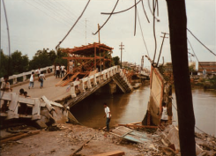
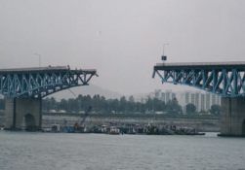
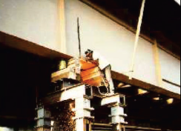
Following photos show civil infrastructures, aircraft, and mechanical systems where structural health monitoring a systems can be deployed.
(Source: Los Alamos National Laboratory, Review of structural health monitoring literature: 1996-2001).
1. Bridge failure from soil liquefaction during a 1990 earthquake in the Philippines
2. One span of the Sung-Soo Grand Bridge over the Han River in Seoul, South Korea fell into the river, killing 20 people and injuring about 30 people. This bridge had pin connections at the span connection points, and
the linkage pins that broke up because of heavy traffic (Courtesy of Seoul National University).
3. Simulated damage was introduced to one girder of the I-40 bridge in New Mexico as part of an FHWA funded structural health monitoring study.

Slide 14
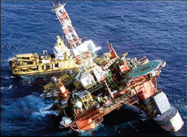

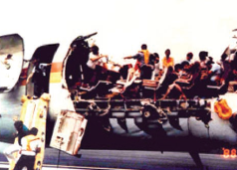
5. Boeing-Sikorsky Rah-66 Comanche Stealth Helicopter. Recently, Health and Usage Monitoring System
(HUMS) for rotorcraft has been initiated by Boeing, Sikorsky, Bell, NASA, the U.S. Army and Navy, and
FAA (Courtesy of United Technologies, Inc.).
6. 1988 Aloha Airlines failure from fatigue cracks in fuselage connections.
4. The failure of the Heidrun offshore oil platform near Brazil (Courtesy of Conoco, Inc.).

Slide 15
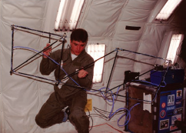
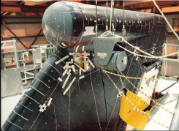
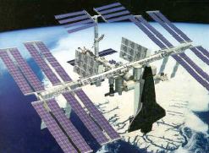
Zero-gravity test of a lightweight space truss structure conducted at the University of Houston (Courtesy of
University of Houston).
Modal Test of Space Shuttle Vertical Stabilizer (Courtesy of University of Houston).
Concept of Space Shuttle docked to the International Space Station (NASA Concept Art, Courtesy of NASA).

Slide 16
Dynamic response of a vibrating structure
Theoretical approach: The equation of motion of a multiple-degree of freedom system with hysteretic damping, which is often used in describing of complex structure’s dynamics
mass [M], hysteretic damping [D], stiffness [K]
If the excitation is harmonic, the relation between the response and the excitation at each frequency is given by:
System receptance matrix, containing all the inforamtion about the dynamic characteristic of the system
One element of the system receptance matrix corresponds to an individual FRF describing the relationship between the response at a particular location/coordinate j and a single force excitation applied at location/coordinate k

Slide 17
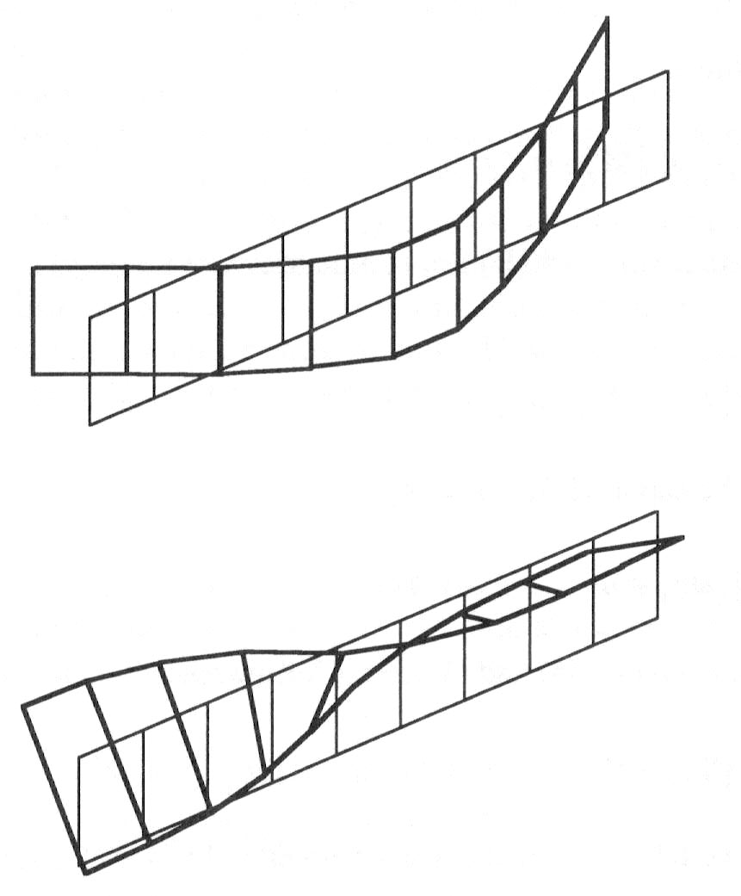
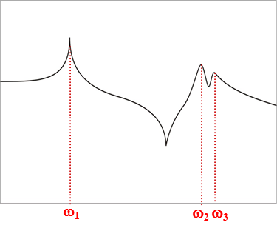
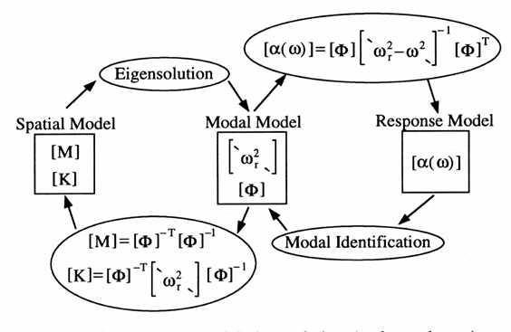
Dynamic response of a vibrating structure
Modal approach:Dynamic parameters which describe dynamic behaviour of a structure are:
Natural frequencies
Modal shapes
Modal damping
These parameters can be derived from:
The Spatial model, given by matrices of mass [M], damping [C], stiffness [K]
The Modal model, given by matrices of eigenvalues [`ω2 ̖] and eigenvectors [Φ]
The Response model, given by receptance matrix [α(ω)]

Slide 18
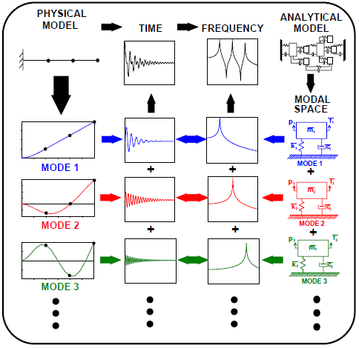
The difference between
time domain,
frequency domain and modal space
An example of a simple cantilever beam:
The beam is excited by a pulse at the tip of the beam.
The response will contain the response of all modes of the system; notice that there appears to be response at several different frequencies.
This time response of the beam can be converted to the frequency domain by performing a Fourier Transform of the time signal (FFT)
The frequency domain representation of this converted time signal is often referred to as the frequency response function (FRF); notice that there are peaks in this plot which correspond to the natural frequencies of the system.

Slide 19
Advantages of
vibration based
damage detection technique
Modal parameters can be measured to any vibrating structure.
Modal parameters are sensitive indicators of physical changes occurred in a structure.
Changes in natural frequencies may indicate the existence of structural damage.
Changes in mode shapes may indicate the location of the damage.
Damage can also be detected for parts of the structure that are not available for measurement.
A small number of measurements are sufficient to detect damage.
Numerous methods for structure excitation and signal processing are in use.
Modal testing is a non-destructive testing technique.

Slide 20
One approach to damage detection using FRF data:
The method based on
the Detection and Relative damage Quantification indicator (DRQ)
This method uses the changes in the frequency response functions (FRF) to detect, locate and relatively quantify the damage.
The main advantages of the method are:
it is not necessary to perform modal identification
there is no need for any analytical or numerical model of the structure
it uses all measured data in the form of frequency response functions, without further treatment.

Slide 21
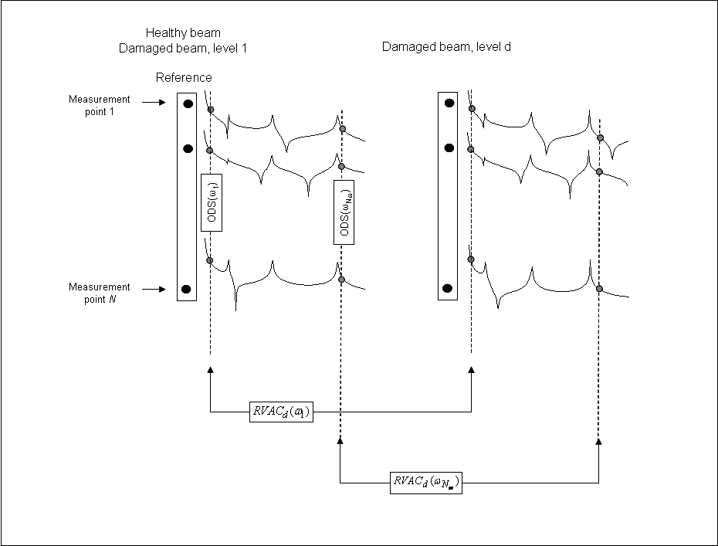
This method is based on
comparison between two different states of the system, one of them is assumed to represent the initial and undamaged state.
Damaged beam, damage level “d”
Undamaged beam, damage level “0”
FRFs
of damaged beam
FRFs
of undamaged beam

Slide 22
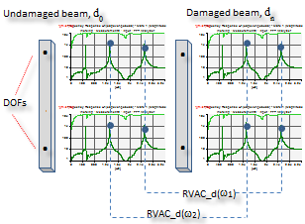
To measure the degree of correlation between two vectors, the response vector assurance criterion (RVAC) was defined
The main question is how to correlate the differences between FRFs data before and after damage to the spatial stiffness changes.
Response Vector Assurance Criterion (RVAC):
The Detection and Relative damage Quantification indicator (DRQ)

Slide 23
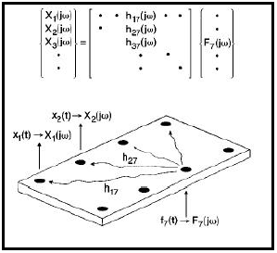
How to measure FRF
on a real beam structure?
Experimental modal analysis
output
motion
response
H(ω)
=
=
=
input
force
excitation
System matrix
Frequency domain:
F_{k}(ω)
Mechanical system
[H(ω)]
X_{j}(ω)
One element of system matrix is FRF:

Slide 24
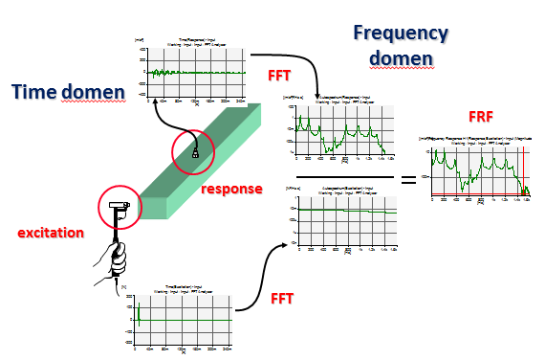
Modal testing for FRF measurement

Slide 25
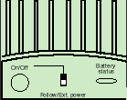
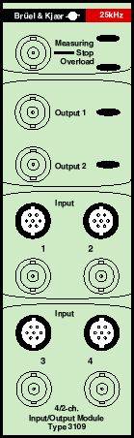
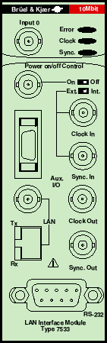

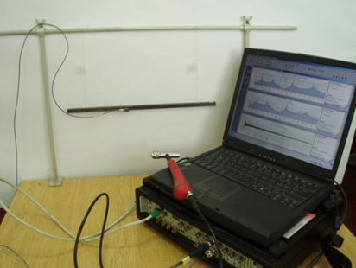
Basic measurement chain
The excitation mechanism
The sensing mechanism
The data acquisition and processing mechanism
4-chanlel Portable Pulse 3560C, Bruel&Kjaer
Modal hammer, ENDEVCO
Modal accelerometers, typr 4507

Slide 26
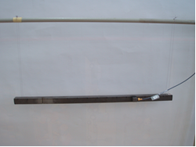
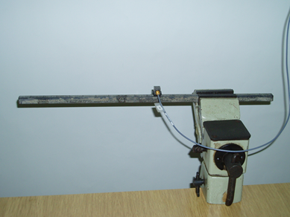
One example of the damage identification procedure according to the level 1 (damage detection), level 2 (damage location) and level 3 (damage quantification) is presented.
  Experimental investigation was conducted for:
  the freely supported steal beam, dimensions 400×15×15 mm
  the cantilever steel beam, dimensions 400×10×10 mm

Slide 27
The damage was propagated by deepening the cut for 1 mm at every level of damage.
Level of damage „d“ | 1 | 2 | 3 | 4 | 5 | 6 | 7
Depth of cut [mm] | 0 | 0 | 1 | 2 | 3 | 4 | 5
The damage was simulated by introducing the 0.5 mm wide cut (by wire-cut) at a certain location of the beam
h
d₀ cd₁ d₂ d₃ d₄ d₅
b
Test 1: damage is close to the place of fixing
14 13 12 11 10 9 8 7 6 5 4 3 2 1
Test 2: damage is in vicinity of the 3th mode node
14 13 12 11 10 9 8 7 6 5 4 3 2 1
Test 3: damage is far away from the place of fixing
14 13 12 11 10 9 8 7 6 5 4 3 2 1

Slide 28
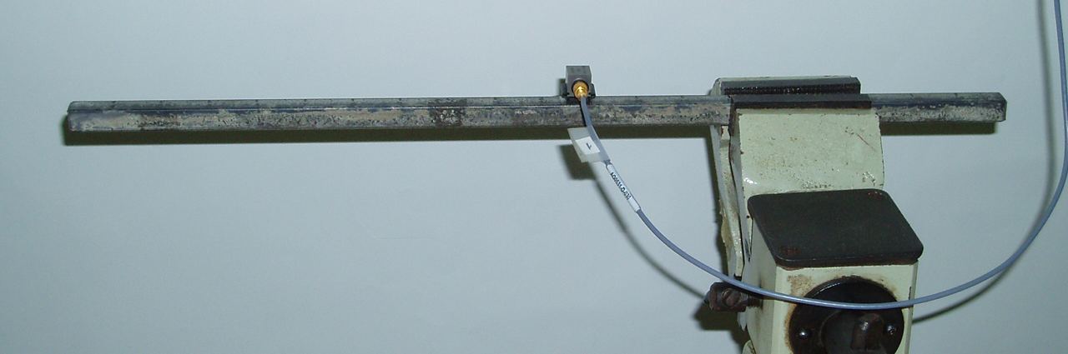
14
13
12
11
10
9
8
7
6
5
4
3
2
1
•
•
•
•
•
•
•
•
•
•
•
•
•
α_{ij}
••
•
••
•
••
•
α_{11,1}
α_{11,2}
α_{11,14}
One rove of FRF matrix is measured:
…
[α(ω)] =
••
•
•
•
••
•
•
•
••
•
•
•

Slide 29
Overlapped FRFs measured for all 14 DOF of the undamaged beam
There are 4 resonance peaks in the measurement frequency band, indicating 4 natural frequencies of the beam

Slide 30
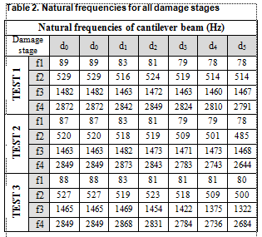
Damage detection
Level 1: damage existence
Overlapped FRFs measured at one DOF (DOF 11), for 7 levels od damage:
There is some frequency shift due to increase of the damage.
Resonant peaks move to the left (decreasing frequencies) due to the beam stiffness decreases (when level of damage increases).
Test 1
Test 2
Test 3

Slide 31
Damage detection
Level 2: damage location
For the purpose to locate the damage,
the General Damage Index was used:
Index GDI has to be calculated for each DOF of the cantilever (marked with p in this equation) and for each stage of damage (marked by d). The number of natural frequencies in the band of interest is marked by N.
FRF curvature
Calculted for each location p= 1÷14

Slide 32
Damage detection
Level 2: damage location
Test 1
Test 2
Test 3
It is obvious for the test 1 that there is a problem with identification of damage if damage is located near the place where beam is clamped. If the damage is located at some nodal point of the structure, such as in the test 2, there is no problem that GDI identify a location of damage. Good identification is achieved in test 3, where a damage is located far away from the location where the beam is clamped.

Slide 33
It is obvious that DRQ indicator shows decreasing trend with increasing the level of damage. Therefore, the DRQ indicator is able to detect and relatively quantify damage.
Damage detection
Level 3: damage quantification
using DRQ indicator
 | RVAC_10 | RVAC_20 | RVAC_30 | RVAC_40 | RVAC_50
f1 | 0.999872051 | 0.999192203 | 0.99711702 | 0.991762724 | 0.978867429
f2 | 0.999983957 | 0.999909398 | 0.999699147 | 0.99917431 | 0.997902756
f3 | 0.999992161 | 0.999969631 | 0.99993235 | 0.999874514 | 0.999773038
f4 | 0.999967454 | 0.999866042 | 0.999672995 | 0.999314367 | 0.998581832
DRQ | 0.999953906 | 0.999734318 | 0.999105378 | 0.997531479 | 0.993781264
It is obvious that DRQ indicator shows decreasing trend with increase of the damage level. Therefore, the DRQ indicator is able to detect and relatively quantify damage
Level of damage

Slide 34
ADVANTAGES OF
VIBRATION-BASED
DAMAGE DETECTION TECHNIQUES
Modal parameters can be measured on any vibrating structure
Modes are sensitive indicators of structure′s physical changes
Changes in the modes can indicate the location of damage
The damage can be detected even for parts of the structure which are not accessible for measurement
A few measurements are enough to detect damage
Numerous methods for structure excitation and processing of the measured signal are in use.

Slide 35

Thank you
for your attention
Contact info about the presenter:
valentina.golubovic-bugarski@mf.unibl.org
Knowledge FOr Resilient soCiEty

